Slide 1


Concurrency

Slide 2
Contents
Threads
Data synchronization
Concurrent Data Types
Executors
Deadlocks

Slide 3
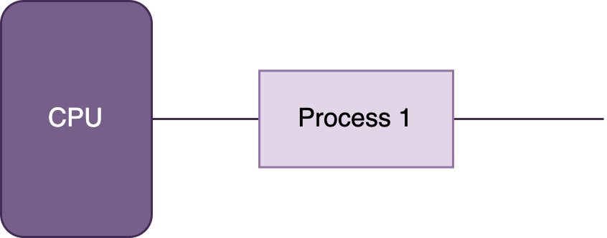
Task

Slide 4
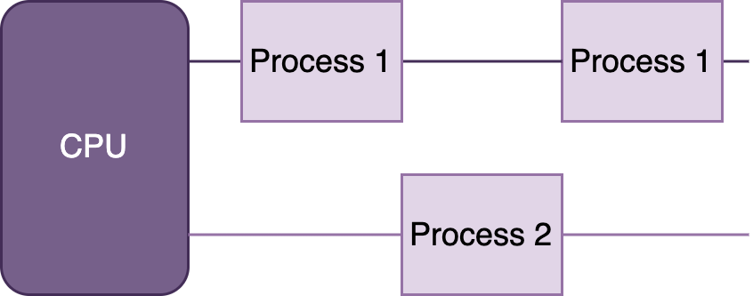
Multitasking

Slide 5
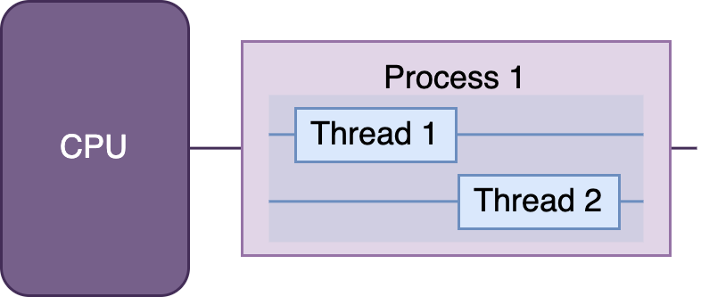
Multithreading

Slide 6
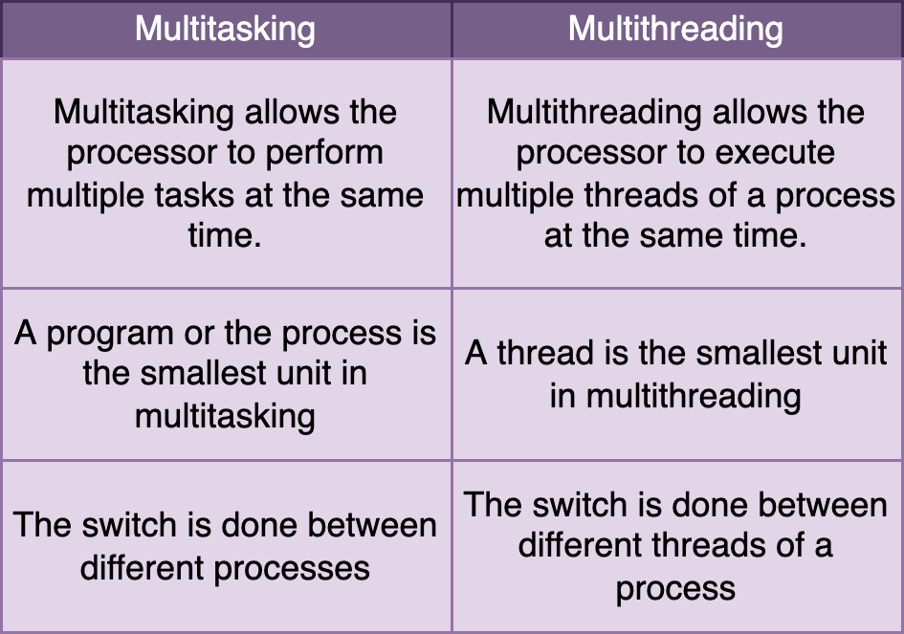
Multitasking vs Multithreading

Slide 7

Example - Thread creation

Slide 8
Extend thread vs Implement runnable
If you need own Thread rules upon which multiple tasks will rely, such as a priority Thread, extending Thread may be preferable.
Extending Thread does not allow you to extend any other class, whereas implementing Runnable lets you extend another class.
Implementing Runnable is often a better object-oriented design practice since it separates the task being performed from the Thread object performing it.
Implementing Runnable allows the class to be used by numerous Concurrency API classes.

Slide 9
Implement callable
Similar to Runnable, but returns a value and can throw a checked exception
Runnable | Callable
@FunctionalInterface public interface Runnable { public abstract void run(); } | @FunctionalInterface public interface Callable<V> { V call() throws Exception; }

Slide 10
Example - Thread creation (Callable)

Slide 11
Thread types
System - created by the JVM and runs in the background of the application (GC).
User-defined - one created by the application developer to accomplish a specific task.
Daemon - one that will not prevent the JVM from exiting when the program finishes. Both system and user-defined threads can be marked as daemon threads

Slide 12
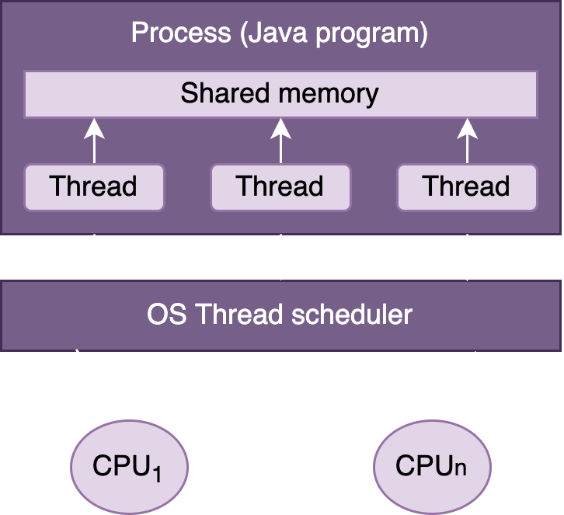
Process model

Slide 13
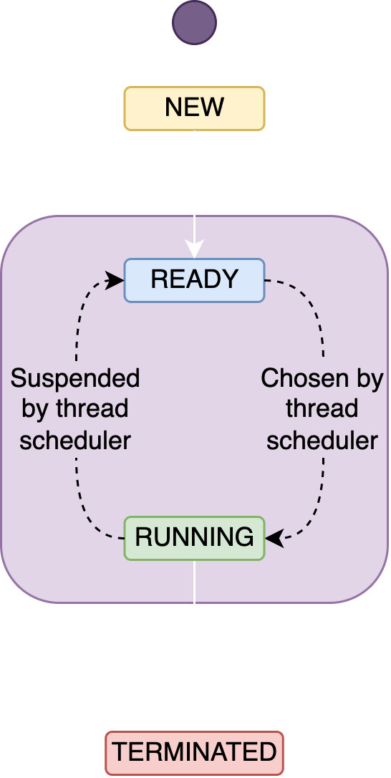
Thread lifecycle

Slide 14
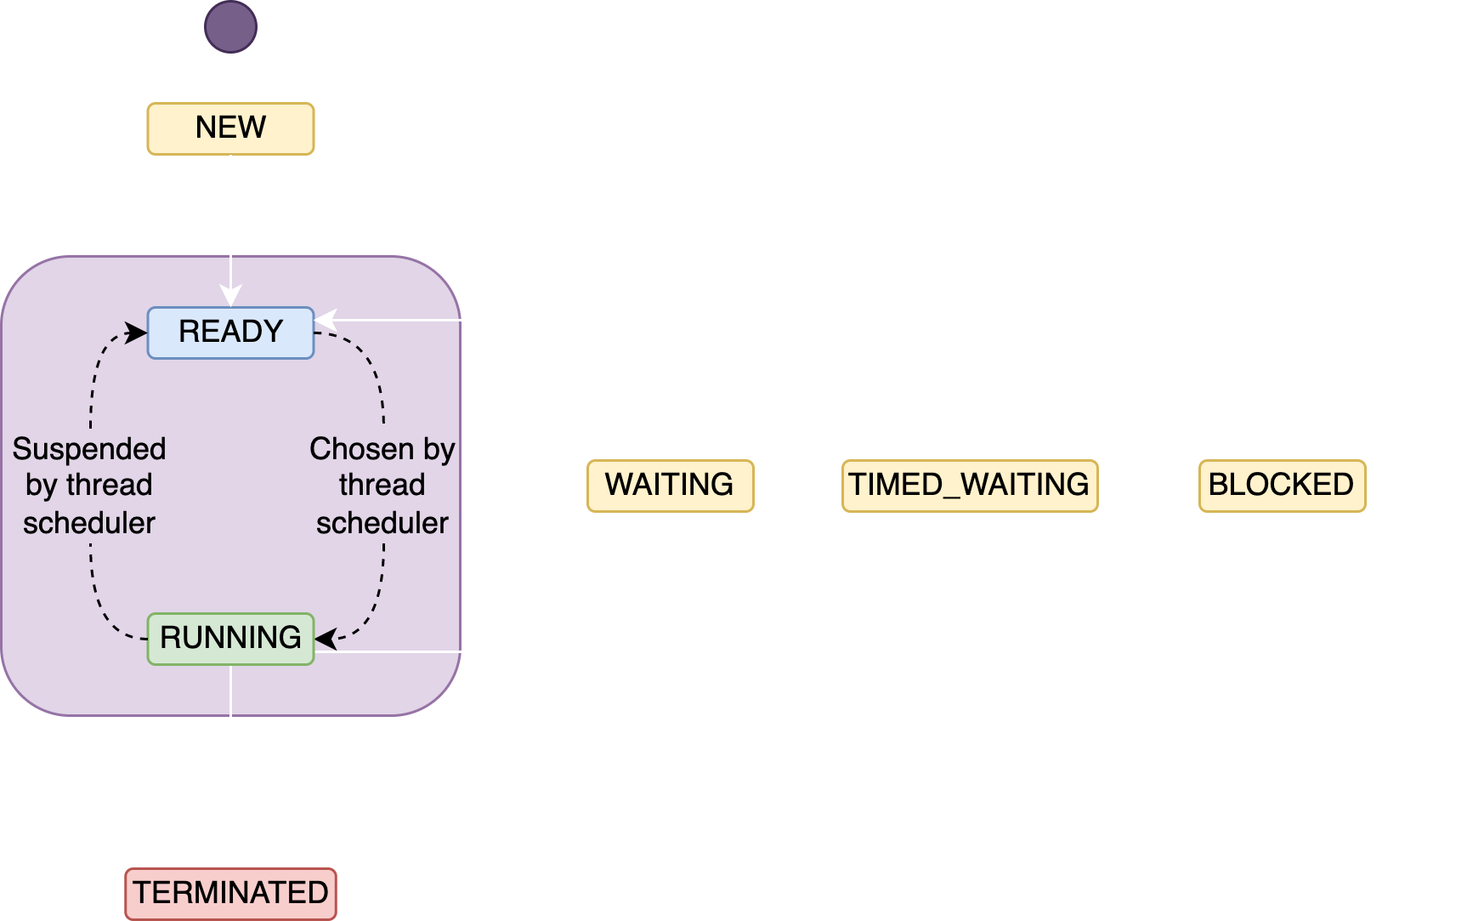
Thread lifecycle

Slide 15
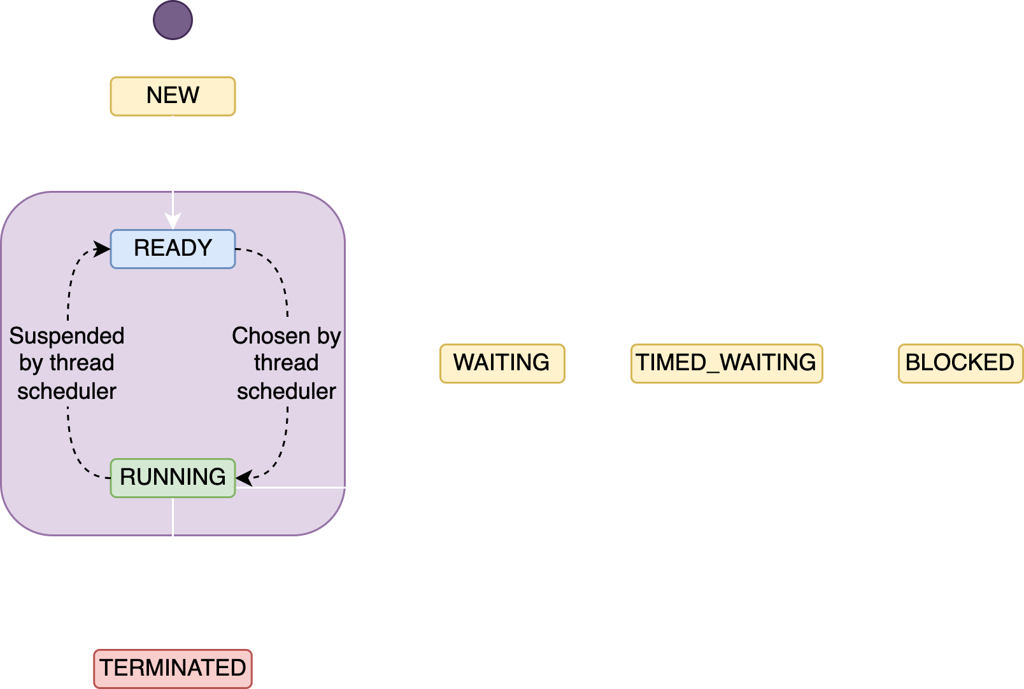
Thread lifecycle

Slide 16
Example - How to work with threads

Slide 17
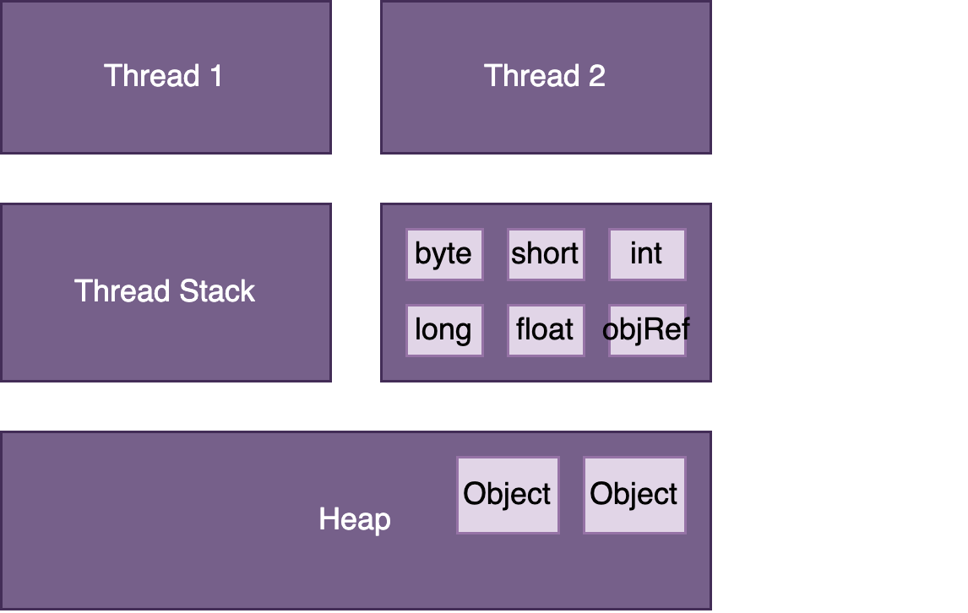
Java Memory Model

Slide 18
Example - Thread Stack

Slide 19
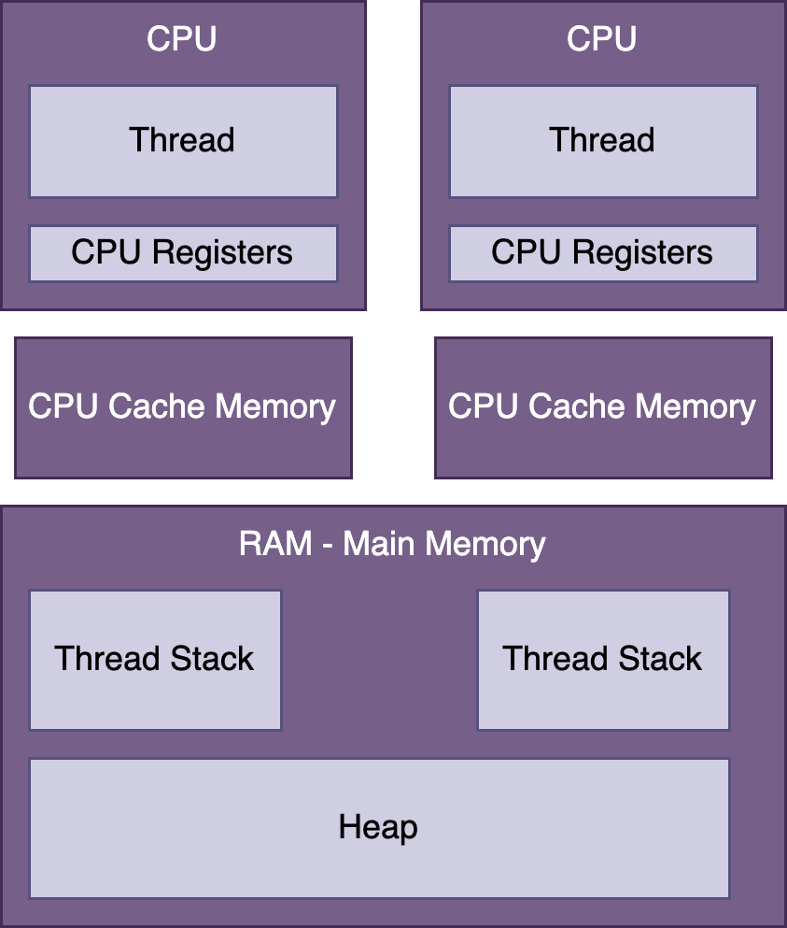
Hardware Memory Architecture

Slide 20
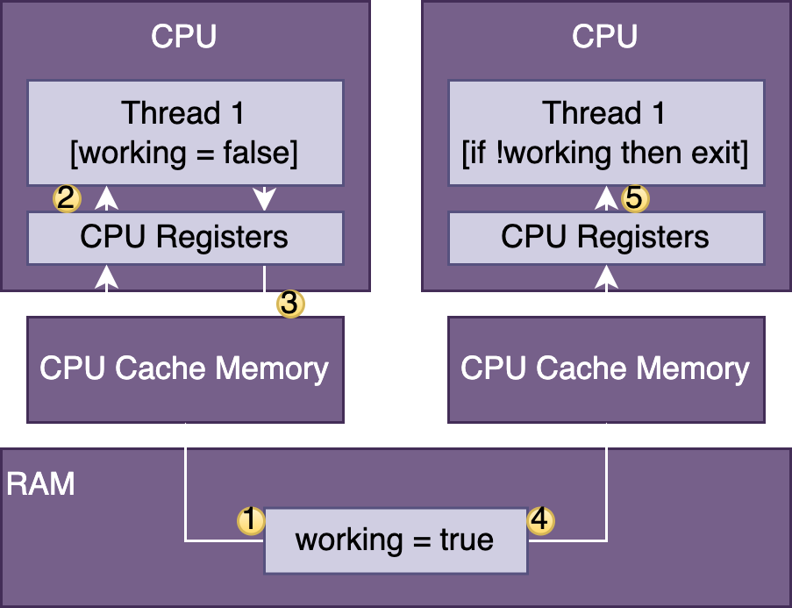
Visibility Between Threads
public class SharedObject {
boolean working = false;
}

Slide 21
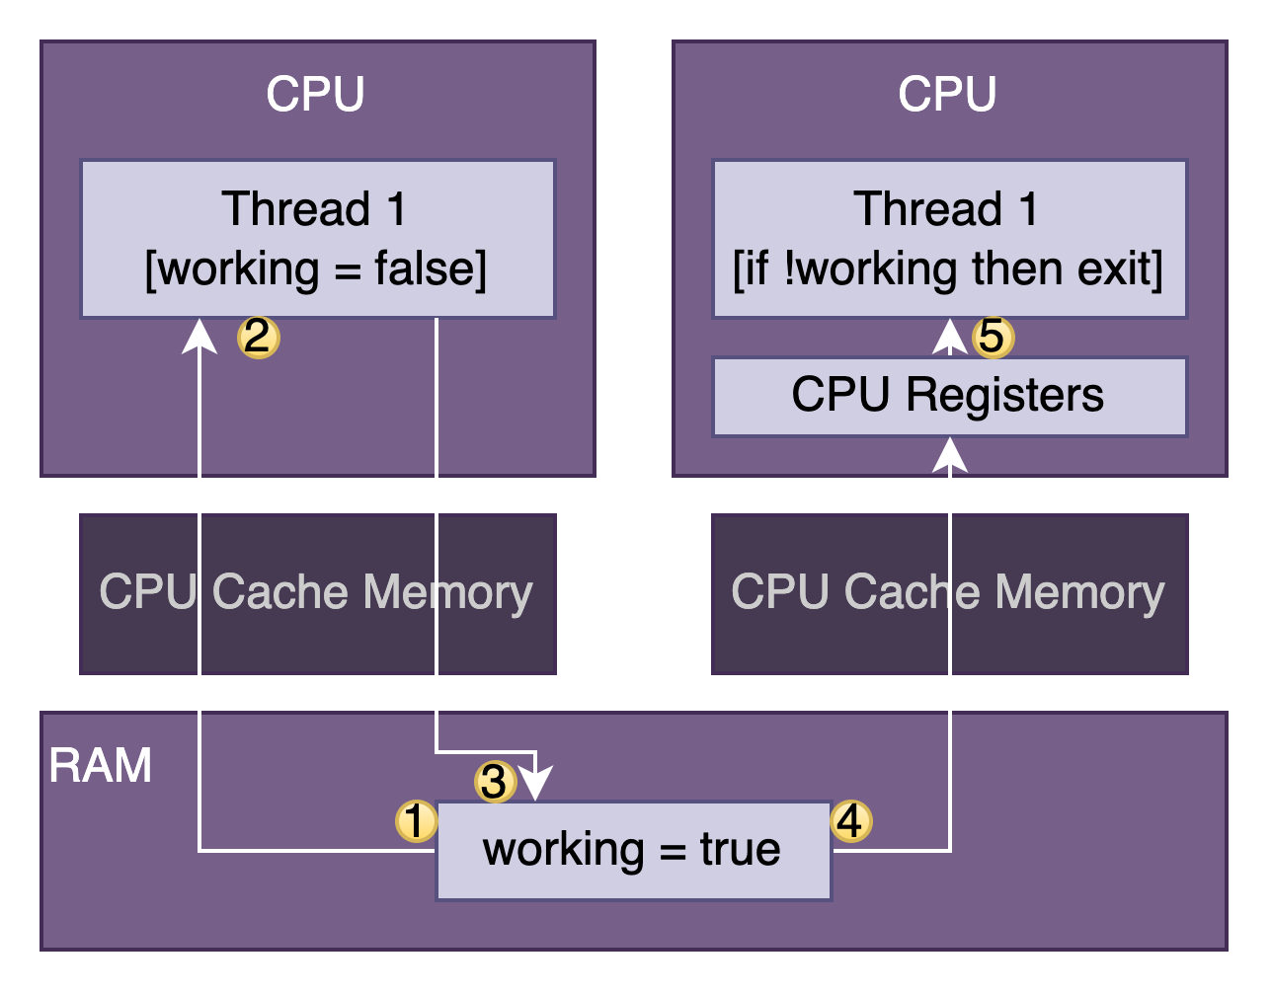
Visibility Between Threads
public class SharedObject {
volatile boolean working = false;
}

Slide 22
Example - Volatile keyword

Slide 23


Synchronizing problem
TrainThread train1 = new TrainThread();
TrainThread train2 = new TrainThread();
train1.start();
train2.start();
Could happen when:
Write to the same file
Change an object, a variable
etc.

Slide 24
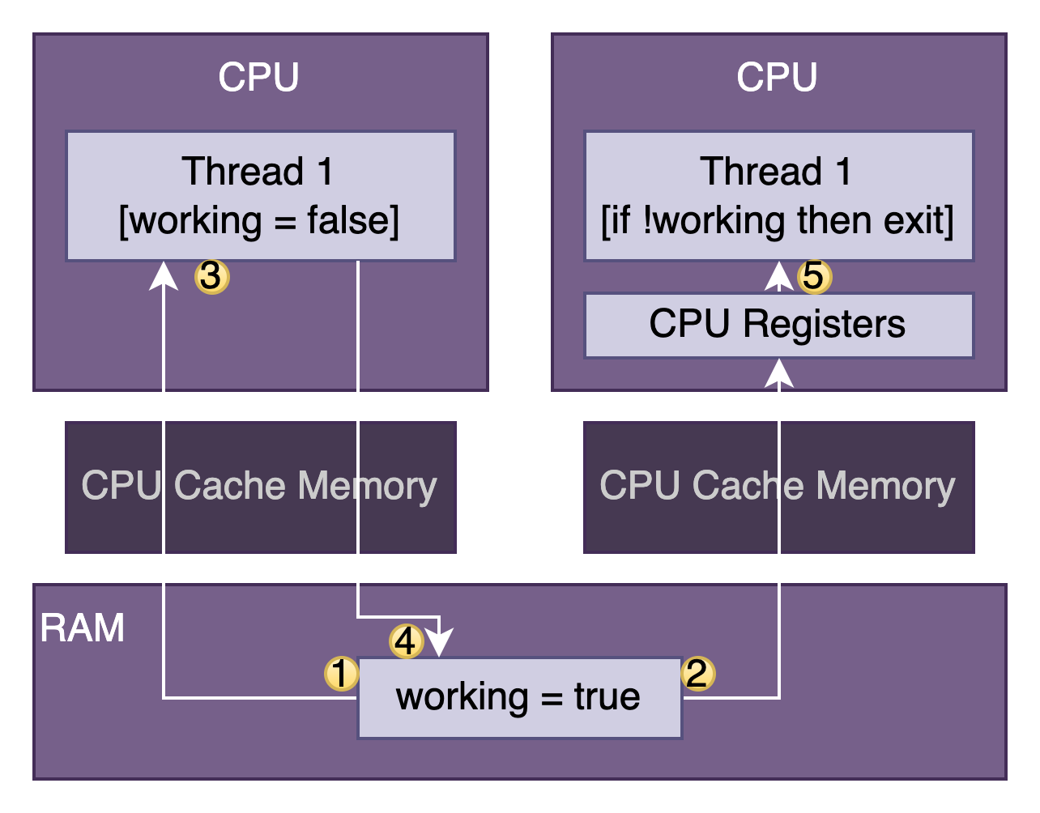
Synchronizing problem

Slide 25
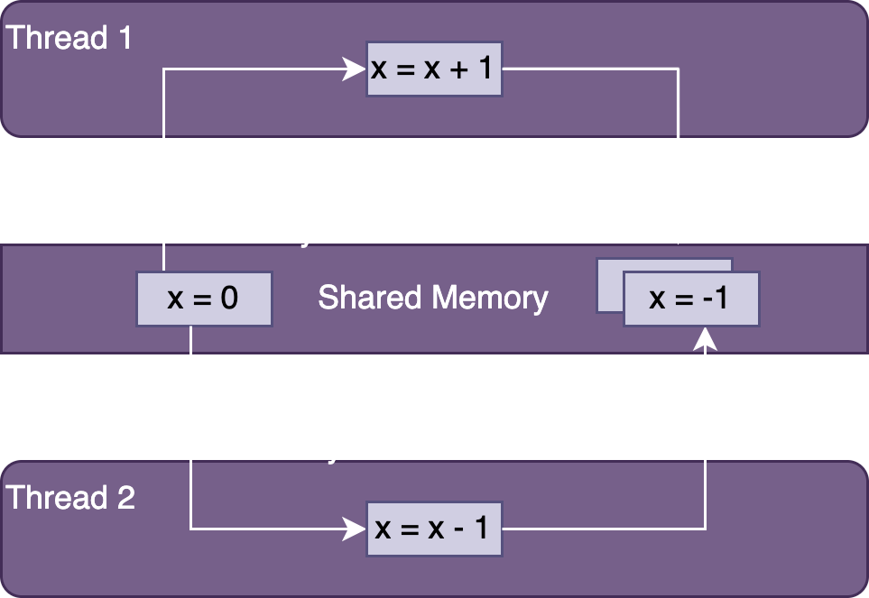
Synchronizing problem

Slide 26
Synchronizing problem
class Counter {
private volatile int c = 0;
public void increment() {
c = c + 1;
}
public void decrement() {
c = c - 1;
}
}
Thread 1 (increment) | Thread 2 (decrement)
1: Retrieve c (0) | 2: Retrieve c (0)
3: 0 + 1 = 1 | 4: 0 – 1 = -1
5: Store result; c = 1 | 6: Store result; c = -1

Slide 27
Synchronizing solution
A monitor is a structure that supports mutual exclusion or the property that at most one thread is executing a particular segment of code at a given time
Thread1
Thread2
Thread3
Monitor
Resource

Slide 28
Synchronizing solution
class Counter {
private volatile int c = 0;
public synchronized void increment() {
c = c + 1;
}
public synchronized void decrement() {
c = c - 1;
}
}
Thread 1 (increment) | Thread 2 (decrement)
1: Retrieve c (0)
2: 0 + 1 = 1
3: Store result; c = 1
 | 4: Retrieve c (1)
 | 5: 1 – 1 = 0
 | 6: Store result; c = 0

Slide 29
Example - Thread Synchronization

Slide 30
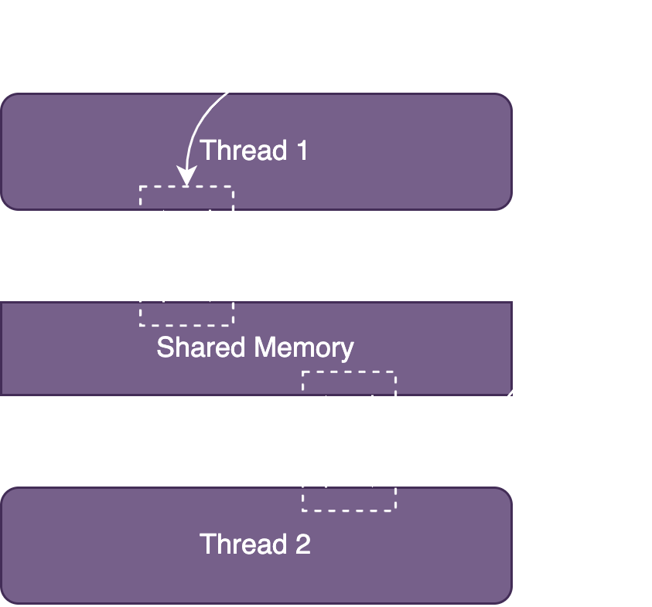
Synchronization Using Atomic
Atomic is the property of an operation to be carried out as a single unit of execution without any interference by another thread.
Using the atomic classes ensures that the data is consistent between workers and that no values are lost due to concurrent modifications.

Slide 31
java.util.concurrent.atomic
AtomicBoolean
AtomicInteger
AtomicIntegerArray
AtomicLong
AtomicLongArray
AtomicReference
AtomicReferenceArray

Slide 32
Example - Atomic

Slide 33
Concurrent Collections
public class ZooManager { private Map<String, Object> foodData = new HashMap<String, Object>(); public synchronized void put(String key, String value) { foodData.put(key, value); } public synchronized Object get(String key) { return foodData.get(key); } }

Slide 34
Concurrent Collections
public class ZooManager { private Map<String, Object> foodData = new ConcurrentHashMap<String, Object>(); public void put(String key, String value) { foodData.put(key, value); } public Object get(String key) { return foodData.get(key); } }

Slide 35
Executor Service
ExecutorService is a JDK API that simplifies running tasks in asynchronous mode.
You can use Java ExecutorService to create a single thread, a pool of threads, or a scheduled pool of threads.

Slide 36
Submit vs Execute
void execute(Runnable command) – returns nothing, “fire-and-forget”
Future<?> submit(Runnable task) - returns a Future object, allows Callable

Slide 37
Future
boolean isDone() - returns true if the task was completed, throw an exception, or was cancelled.
boolean isCancelled()- returns true if the task was cancelled before it completely normally.
boolean cancel() - attempts to cancel execution of the task.
V get() - retrieves the result of a task, waiting endlessly if it is not yet available.
V get(long timeout, TimeUnit unit) - retrieves the result of a task, waiting the specified amount of time. If the result is not ready by the time the timeout is reached, a checked TimeoutException will be thrown.

Slide 38
Example - Executors

Slide 39

Scheduler

Slide 40
Example - Schedulers

Slide 41
Scheduler tasks
schedule (Callable callable, long delay, TimeUnit unit) - Creates and executes a Callable task after the given delay
schedule (Runnable command, long delay, TimeUnit unit) - Creates and executes a Runnable task after the given delay
scheduleAtFixedRate (Runnable command, long initialDelay, long period, TimeUnit unit) - Creates and executes a Runnable task after the given initial delay, creating a new task every period value that passes.
scheduleAtFixedDelay (Runnable command, long initialDelay, long delay, TimeUnit unit) - Creates and executes a Runnable task after the given initial delay and subsequently with the given delay between the termination of one execution and the commencement of the next

Slide 42

Deadlock
Thread1
Thread2
synchronized
synchronized
synchronized
synchronized

Slide 43
Deadlock
class A { synchronized void methodA(B b) { b.doSomething(); } synchronized void doSomething() { ...} } class B { synchronized void methodB(A a) { a.doSomething(); } synchronized void doSomething() { ...} }

Slide 44
Example - Deadlock

Slide 45
Useful links
Multithreading

Slide 46

Homework map example

Slide 47

Any questions?
Threads are a pain in the ass

